Slide 1

Manipal University Jaipur
Facial Recognition Attendance System

Slide 2
Introduction
Facial recognition attendance systems are a modern way to track employee attendance and ensure that employees are present and accounted for. This technology uses facial recognition software to identify individuals and record their attendance. It is a secure and reliable way to monitor employee attendance and can help to reduce time-theft and absenteeism.
This technology is becoming increasingly popular in businesses of all sizes, as it helps to reduce costs associated with traditional attendance tracking methods. In addition, facial recognition attendance systems are more secure and accurate than other methods, as it can identify individuals even in large crowds.

Slide 3
Objectives
Expected achievements to fulfill the objectives are:
•To detect the face segment from the video frame.
•To extract the useful features from the face detected.
•To classify the features in order to recognize the face detected.
•To record the attendance of the identified student.

Slide 4
OpenCV and other modules
OpenCV is the huge open-source library for computer vision, machine learning, and image processing and it plays a major role in this project. When integrated with various libraries, such as Dlib, NumPy, python is capable of processing the OpenCV array structure for analysis.
Other important libraries/modules used are –
face_recognition - it is an easy to use set of face recognition utilities that wraps around dlib.
csv - stands for comma separated values, it is used to hand excel files in this project.

Slide 5
Algorithms Overview
To perform the face recognition function, face detection is first performed to determine the position of the face in the picture. The OpenCV method is a common method in face detection. First, it extracts the feature images into a large sample set by extracting the face Haar features in the image and then uses the AdaBoost algorithm as the face detector. In face detection, the algorithm can effectively adapt to complex environments such as insufficient illumination and background blur, which greatly improves the accuracy of detection.
The Haar feature is composed of several identical rectangles, which are distinguished by the black and white difference of colors, and the feature values of the Haar features are defined by the pixel values of the rectangle.

Slide 6
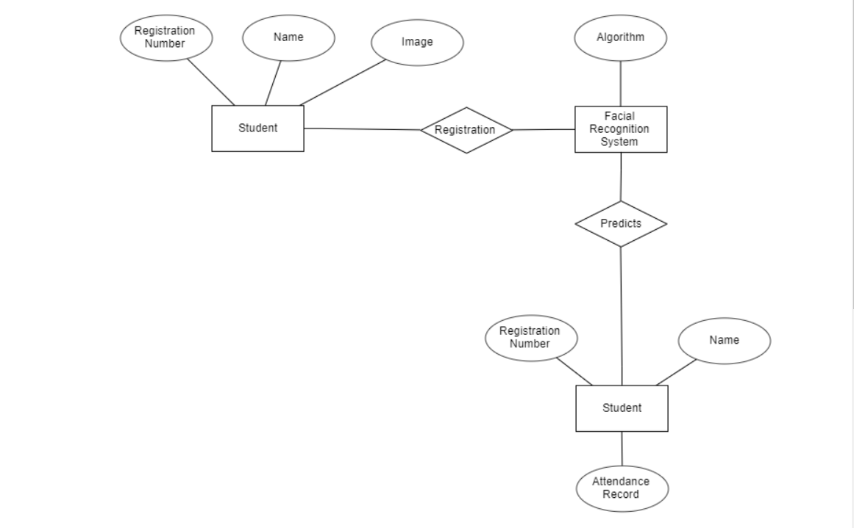
Entity-Relationship Diagram

Slide 7
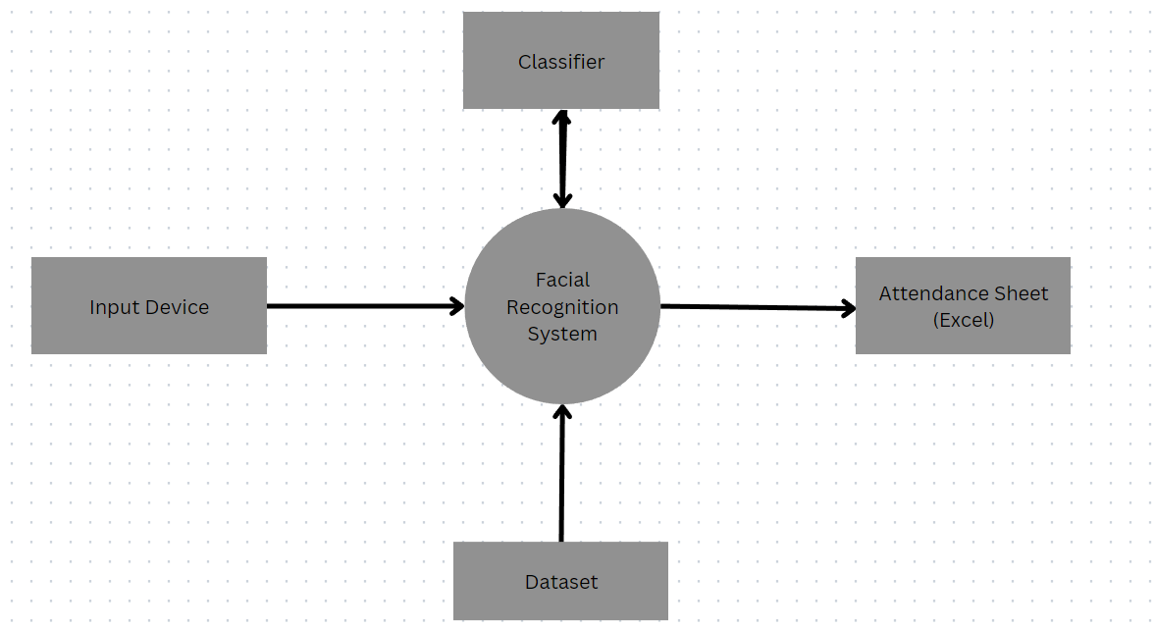
Data Flow Diagram(Level O)

Slide 8
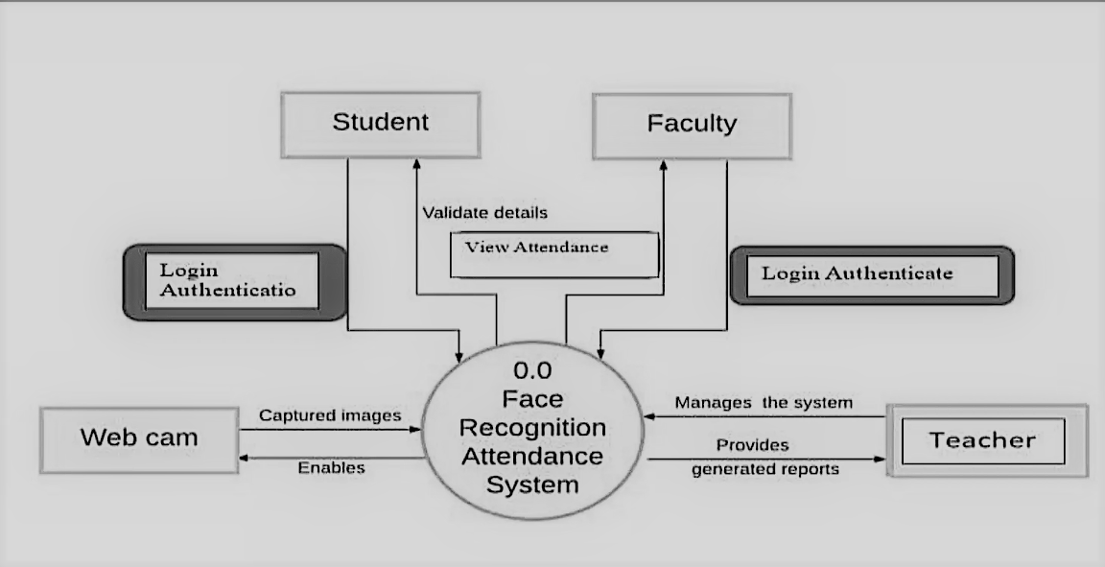
Data Flow Diagram(Level 1)

Slide 9
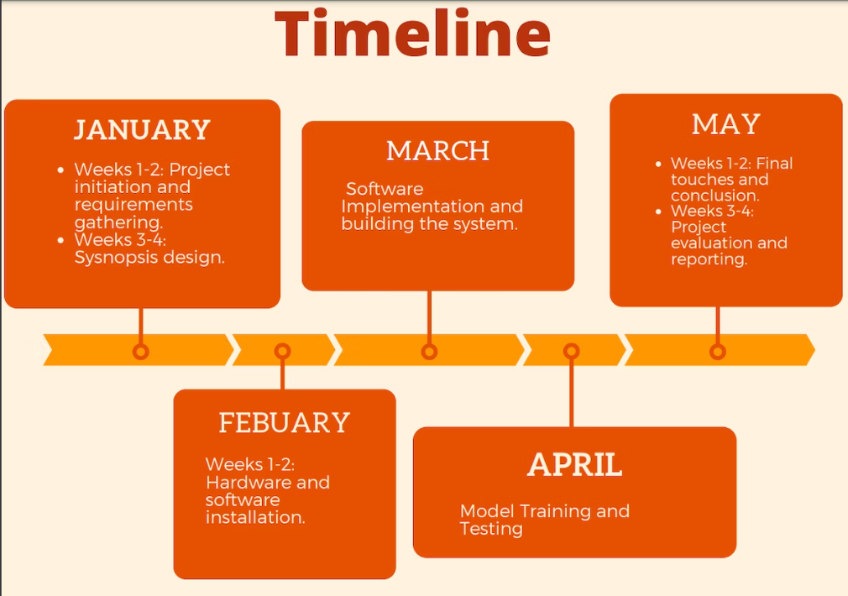

Slide 10
Future Scope
Real-time tracking and monitoring: With the help of advanced computer vision and facial recognition algorithms, the system can provide real-time tracking and monitoring of individuals in various environments, such as workplaces and public spaces.
Enhanced security features: The facial recognition attendance system can be enhanced with additional security features, such as liveness detection, to prevent spoofing and fraudulent attempts to bypass the system.
Expansion of applications: The facial recognition attendance system can be expanded to various other applications, such as security and access control, retail and customer service, and healthcare.

Slide 11
Conclusion
Facial recognition attendance system is an innovative technology that has revolutionized the traditional attendance management system. With its advanced features and accuracy, it has become an ideal solution for organizations and educational institutions. It eliminates the need for manual attendance marking and reduces errors and frauds. Additionally, it helps in maintaining a record of attendance, which can be used for various purposes such as salary calculation, performance evaluation, and compliance purposes.
Overall, facial recognition attendance system is a promising technology that has the potential to transform the way attendance management is done. With proper implementation and maintenance, it can bring numerous benefits to organizations and institutions while ensuring fairness and accuracy in attendance tracking.

Slide 12
Thank You

